Slide 1

Analytics of Car Sales
Presented By :- Bhavini
Under Guidance: Junaid Qazi

Slide 2
Agenda
Problem Statement
Objective
Dataset – Car Sales
What is expected from Data?
Data Model
Visualization
Analysis
Conclusion

Slide 3

Problem Statement
The automotive industry - highly competitive and dynamic
The challenge faced by car manufacturers and dealerships is to understand these trends and preferences to optimize their sales strategies.
Notes:
The automotive industry is highly competitive and dynamic
with consumer preferences and market trends constantly evolving. The challenge faced by car manufacturers and dealerships is to understand these trends and preferences to optimize their sales strategies.

Slide 4
Objective
Identify the key factors that drive car sales growth or decline.
understand overall sales trends over time Increase sale by 20% till end of the year 2024.
Uncover insights that can lead to a targeted increase in car sales by 20% by the end of the year 2024.

Slide 5

Canadian Car Sales Dataset
Sales data across different province
Car models and their sales volumes
Prices
Resell prices

Slide 6

Dataset Source
Data World: https://data.world/
Statistics Canada: https://www.statcan.gc.ca/en/start

Slide 7

What is expected from Data?
Key factors driving sales growth or decline
Overall sales trends over time
Performance metrics for the company
Top selling car models

Slide 8
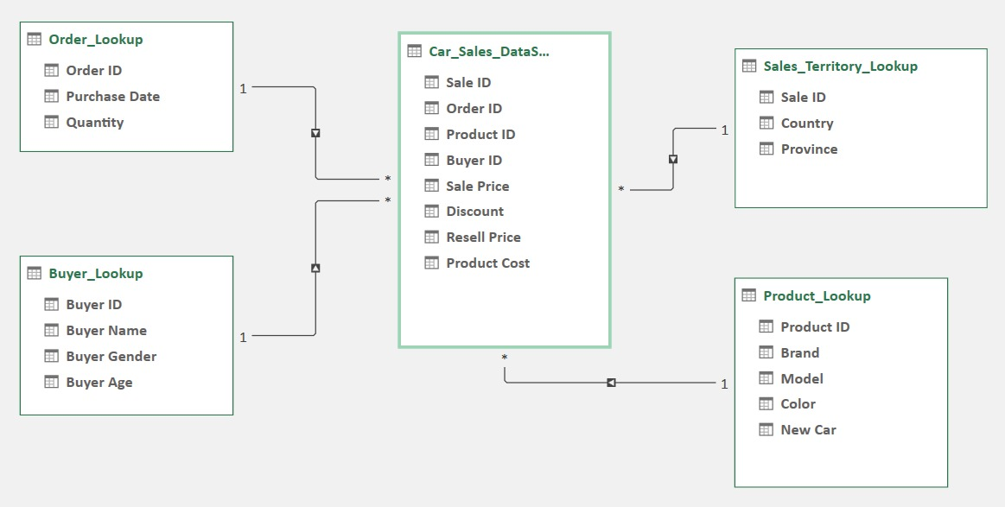
Data Model

Slide 9
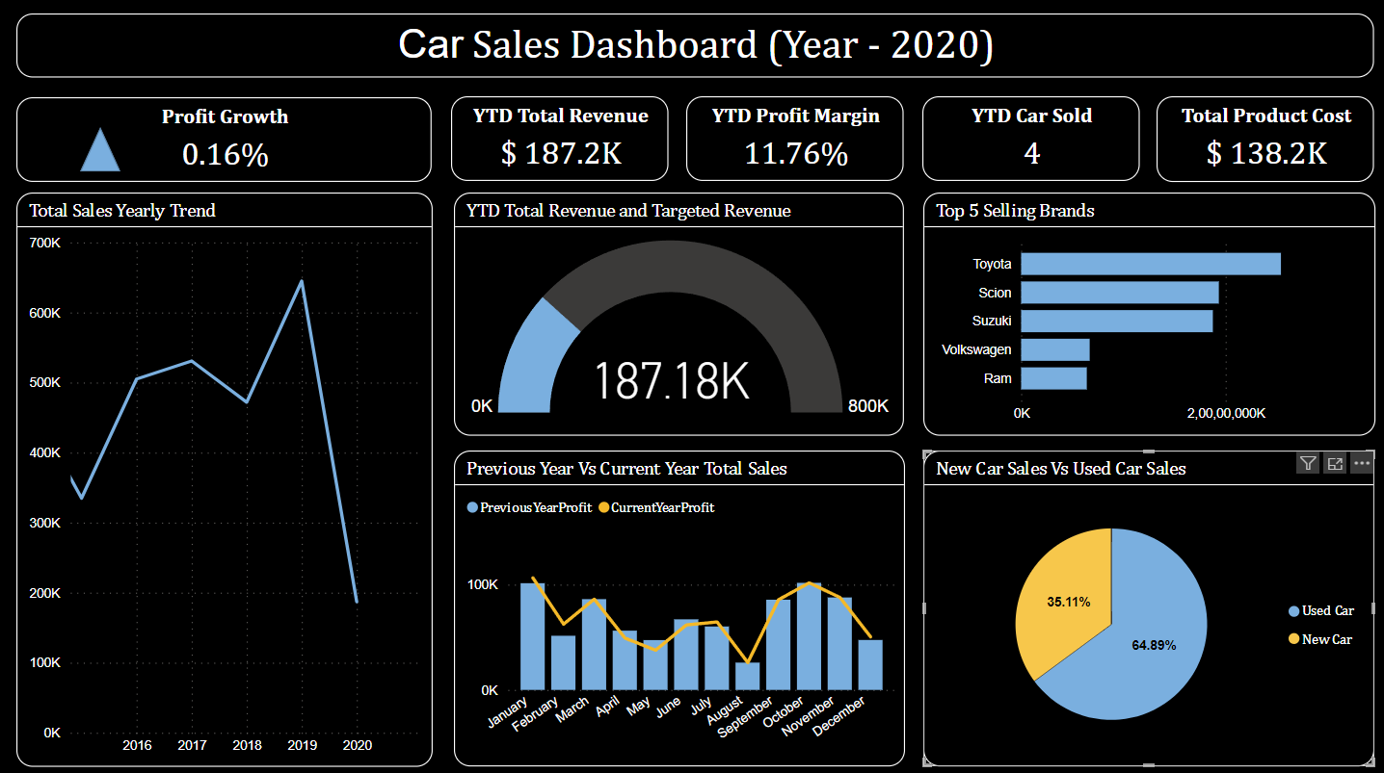
Visualization

Slide 10
Analysis
Total revenue for the current year is $187K which is 23% of the targeted revenue.
Monthly trend of the current year sale is almost at same level as the previous year.
Top Selling Models for each brands.
Sales from new Car Vs used Car

Slide 11
Conclusion
To achieve the objective of increasing sales by 20% by the end of 2024, it is recommended to focus on,
marketing the top-selling models
exploring new market segments
enhancing the customer buying experience.

Slide 12
References
Statistics Canada:
https://www150.statcan.gc.ca/t1/tbl1/en/tv.action?pid=2010000101
Dashboard Creation:
https://www.figma.com/community/file/1238189616000926360/power-bi-car-sales-dashboard

Slide 13
Thank You

